Slide 1
Stonecap Mountain Alpha
Torii Greiskalns

Slide 2
Aims for the Project
Learn more about networking, client-server interactions
Create a fun and well-polished game
Publish a game to a public platform

Slide 3
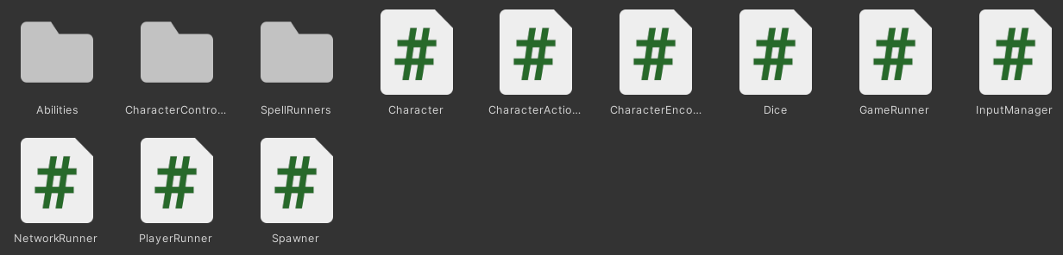
File Structure

Slide 4
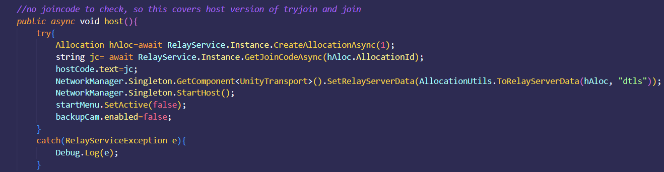
Networking Logic- hosting a lobby

Slide 5
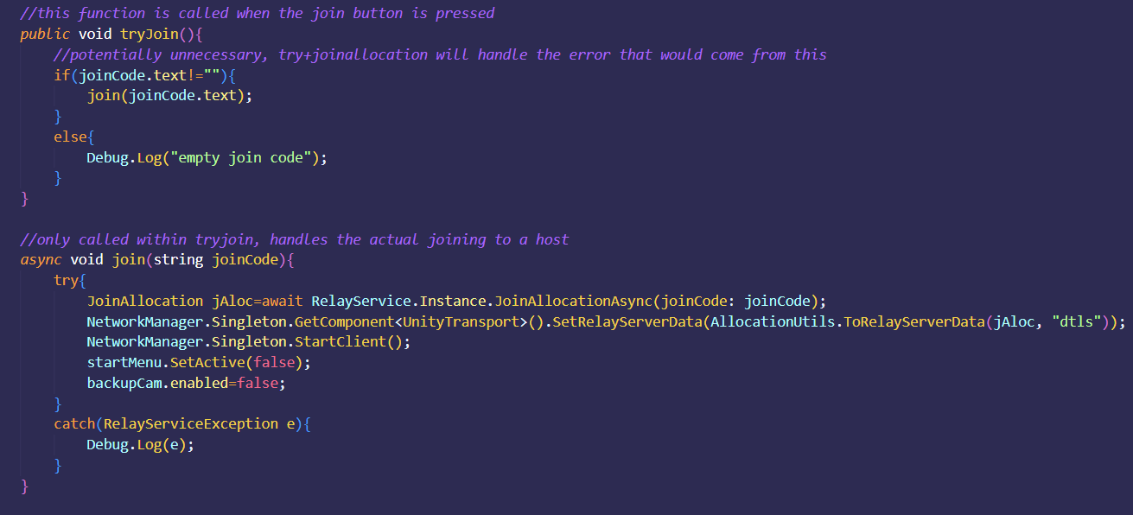
Networking logic- Joining an active lobby

Slide 6
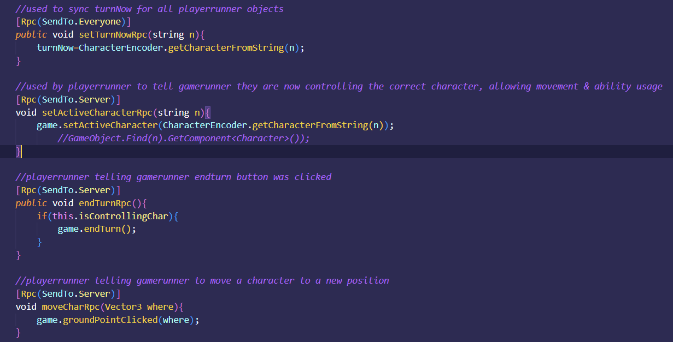
Networking logic- Remote Procedure calls

Slide 7
Issues/struggles
Learning networking in Unity
Separating a game originally developed for 1 machine into a server/client architecture
Creating a lobby & connecting a client to it via Unity Relay
Understanding how to connect machines using RPCs
Syncing game data between clients from server
Getting all clients to display animations & effects

Slide 8
Functioning So Far:
World & characters
Actions/abilities
Animations
Hosting a lobby
Joining a lobby
Viewing any character’s health/name/status in game
Getting permission to control your character from the server
Moving your character when it’s their turn
Ending a characters turn

